Slide 1

TRƯỜNG CAO ĐẲNG LÝ TỰ TRỌNG TP. HỒ CHÍ MINH

Slide 2

KHOA KHOA HỌC CƠ BẢN

Slide 3

ỦY BAN NHÂN DÂN THÀNH PHỐ HỒ CHÍ MINH
TRƯỜNG CAO ĐẲNG LÝ TỰ TRỌNG TP. HỒ CHÍ MINH
Bậc đào tạo: TRUNG CẤP CHUYÊN NGHIỆP
Tên giảng viên: LÊ NGUYỄN MỸ TRÂM

Slide 4
Good afternoon class 19T2.

Slide 5
UNIT 2: FREE TIME ACTIVITIES
(TO BE CONTINUED)

Slide 6
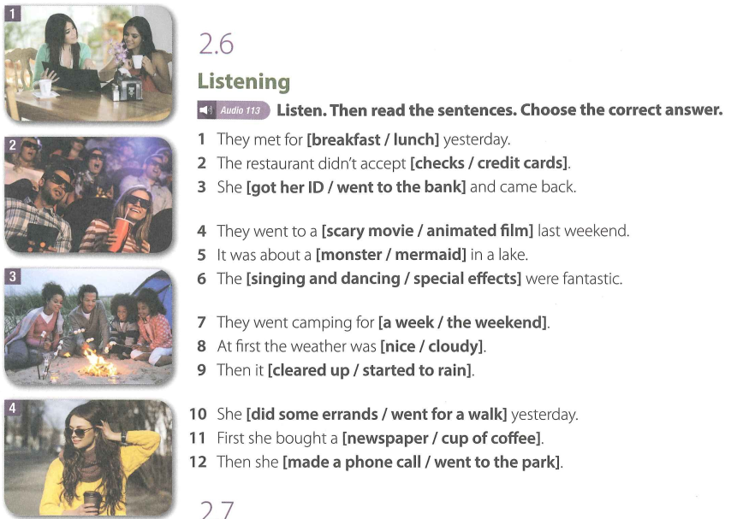


Slide 7
New words:
1. accept (verb) UK /əkˈsept/ US /əkˈsept/:
to agree to take something:
Exs: - Do you accept credit cards?
- She was in Mumbai to accept an award for her latest novel.
- I offered her an apology, but she wouldn't accept it.

Slide 8
New words:
2. credit card (noun [ C ])
UK /ˈkred.ɪt ˌkɑːd/ US /ˈkred.ɪt ˌkɑːrd/
-> a small plastic card that can be used as a method of payment, the money being taken from you at a later time
Exs: - What is the expiry date on your credit card ?
- Would you prefer to pay by cash, cheque or credit card?

Slide 9
New words:
3. ID (noun) [ U ] informal
UK /ˌaɪˈdiː/ US /ˌaɪˈdiː/
ID noun (DOCUMENT)
-> abbreviation for identification: any official card or document with your name and photograph or other information on it that you use to prove who you are:
Ex: Do you have any ID? A driving licence or cheque card will do.

Slide 10
New words:
4. embarrassing (adjective)
UK /ɪmˈbær.ə.sɪŋ/ US /ɪmˈber.ə.sɪŋ/
-> making you feel embarrassed:
Exs: - an embarrassing situation
- [ + to infinitive ] It's embarrassing to be caught telling a lie.
- My most embarrassing moment was trying to introduce a woman whose name I couldn't remember.
- It was embarrassing how few people attended the party.

Slide 11
New words:
5. mostly (adverb)= mainly
UK /ˈməʊst.li/ US /ˈmoʊst.li/
Exs:
- In the smaller towns, it's mostly (= usually) very quiet at nights.
- The band are mostly (= most of them are) teenagers.
- After leaving school, she spent a year travelling, mostly in Africa and Asia.

Slide 12
New words:
6. scary (adjective) informal (UK also scarey)
UK /ˈskeə.ri/ US /ˈsker.i/
-> frightening:
a scary movie/story
Các từ đồng nghĩa:
chilling, fearsome (formal), frightening
Exs:
- She's a scary woman.
- I've always found him a bit scary.

Slide 13
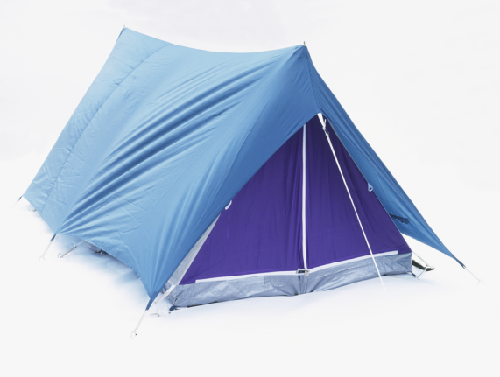
New words:
7. Tent (noun [ C ]) UK /tent/ US /tent/
-> a shelter made of canvas or a similar material and supported by poles and ropes, that you can fold up and carry with you
Exs: - Rain had dampened the tent so we left it to dry in the afternoon sun.

Slide 14

New words:
8. marshmallow (noun) [ C or U ]
UK /ˈmɑːʃˌmæl.əʊ/ US /ˈmɑːrʃˌmæl.oʊ/
-> a soft, sweet, pink or white food:
Ex: Why don't we toast some marshmallows over the fire?

Slide 15
New words:
9. chore noun [ C ]
UK /tʃɔːr/ US /tʃɔːr/
-> a job or piece of work that is often boring or unpleasant but needs to be done regularly:
Exs: - I'll go shopping when I've done my chores (= done the jobs in or around the house).
- I find writing reports a real chore (= very boring).

Slide 16
New words:
10. errand (noun [ C ])
US /ˈer·ənd/
-> a short trip you make to do something, such as buying or delivering things in the neighborhood:
Exs: - He would clean, do errands, and babysit for their 7-year-old daughter.
- I’ve got to run a few errands (= do errands) and then stop by my mother’s.

Slide 17
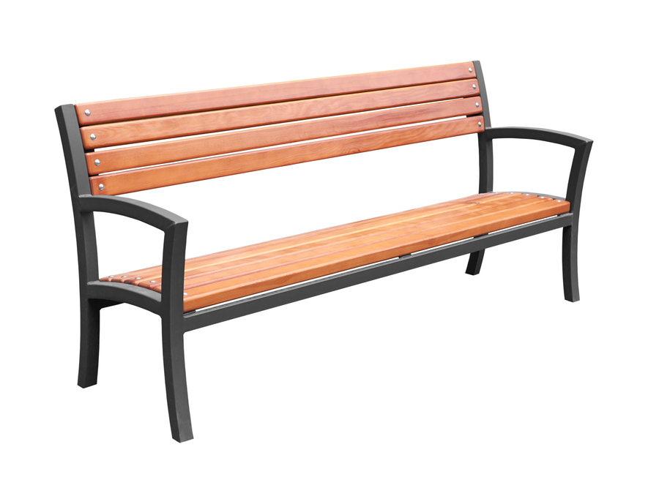
New words:
11. bench (noun)
UK /bentʃ/ US /bentʃ/
-> a long, usually hard seat for two or more people, often found in public places:
Ex: a park bench (= a seat in a public garden)

Slide 19
2.6 Listening (Key)
  They met for [breakfast / lunch] yesterday.
  The restaurant didn’t accept [checks / credit cards].
  She [got her ID / went to the bank] and came back.
  They went to a [scary movie / animated film] last weekend.
  It was about a [monster / mermaid] in a lake.
  The [singing and dancing / special effects] were fantastic.
  They went camping for [a week / the weekend].
  At first one weather was [nice / cloudy].
  Then it [cleared up / started to rain].
  She [did some errands / went for a walk] yesterday.
  First she bought a [newspaper / cup of coffee].
  Then she [made a phone call / went to the park].

Slide 20
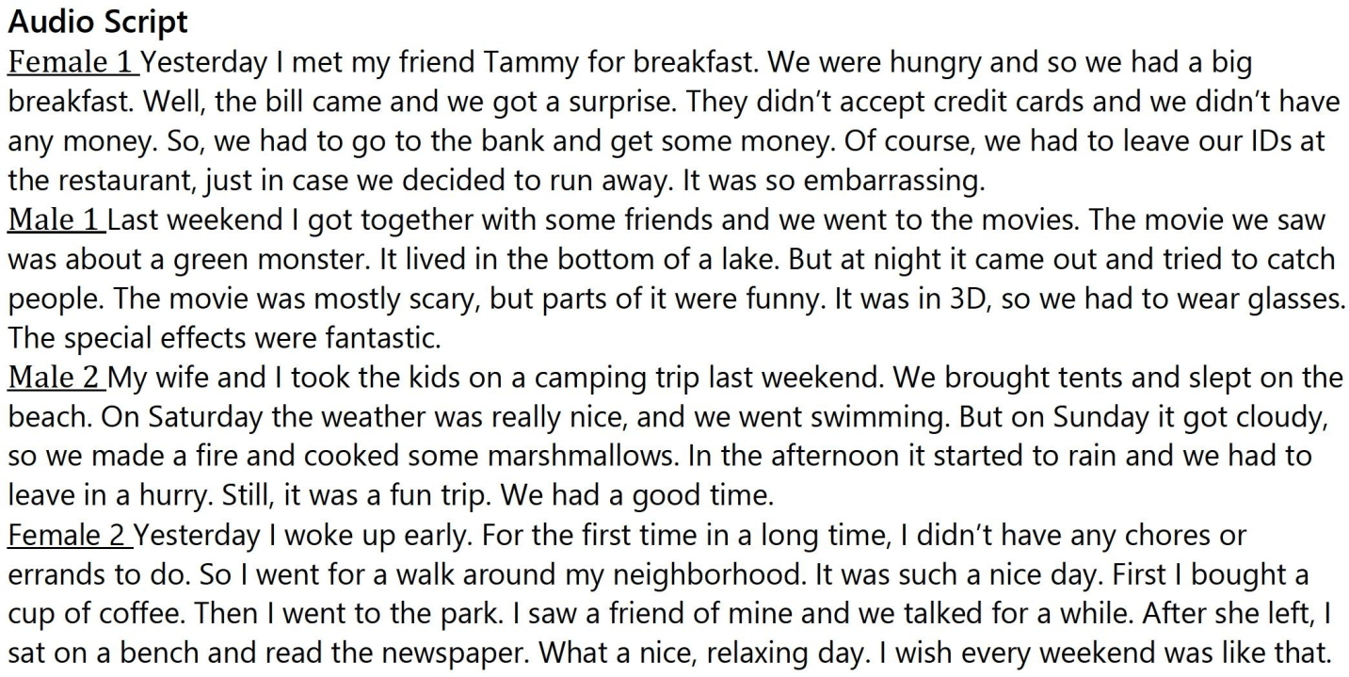

Slide 21
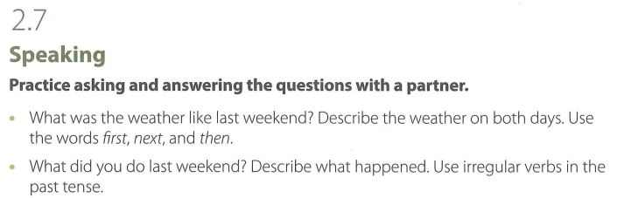

Slide 23
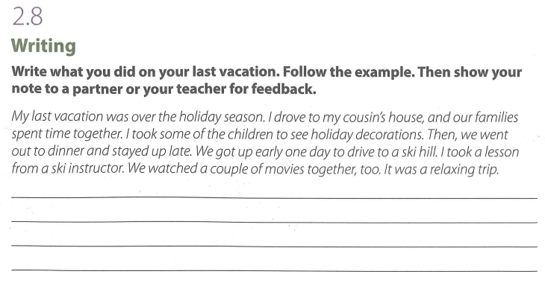

Slide 26
Thank you very much
for
your cooperation.

